Slide 1
Updating drivers with DriverEasy

Slide 2
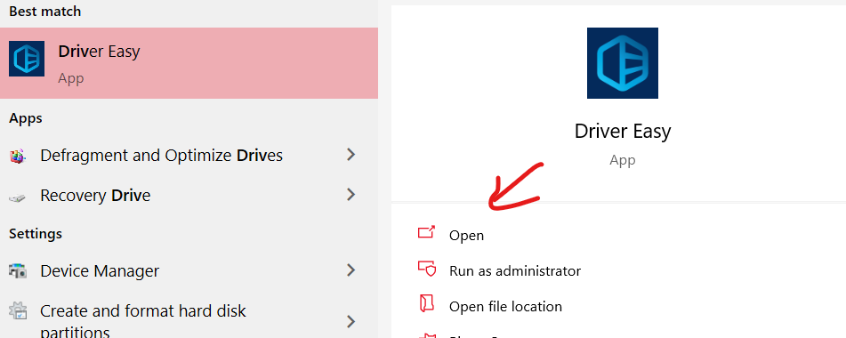
Download and Install DriverEasy
Click this link to begin the download for DriverEasy: https://www.drivereasy.com/DriverEasy_Setup.exe
After it downloads, run the setup installer and click the Install button.
After it installs, if it does not automatically open, search for DriverEasy in the windows search bar and open it.

Slide 3
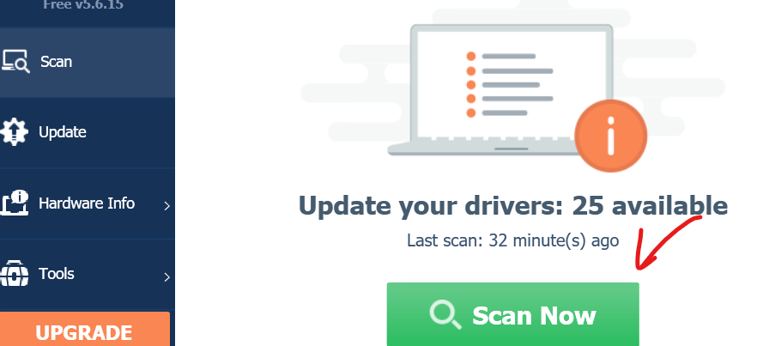
Scan your system
DriverEasy should automatically open on this page
Click the “Scan Now” button and DriverEasy will check to see which Drivers need updated

Slide 4
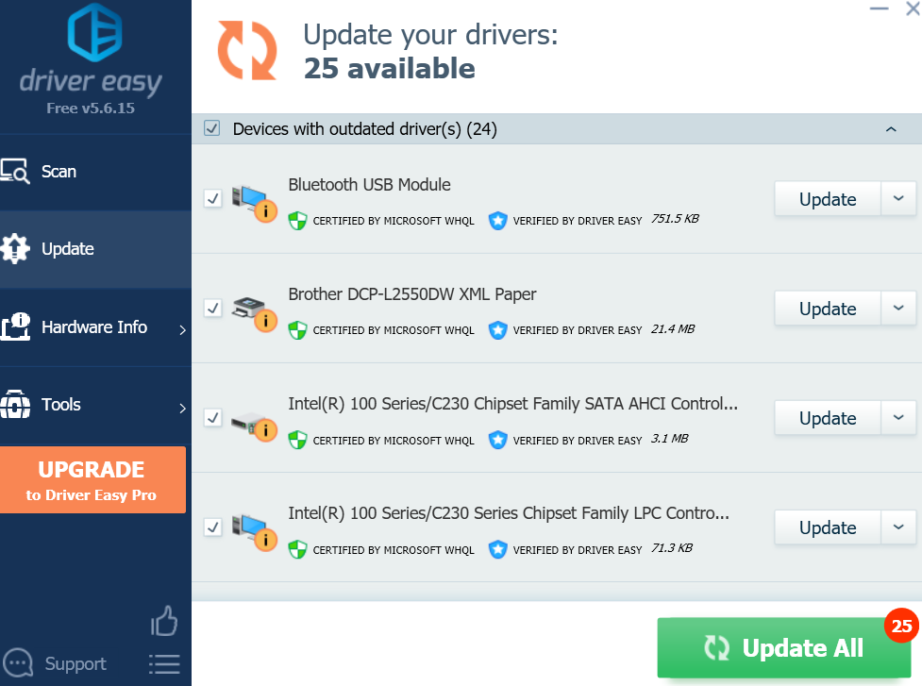
Check drivers
You should now see a page showing all of the drivers that need updated.
It’ll look like this
Good job so far, but now we are going to take a few extra steps just to make the installation process a bit easier.

Slide 5
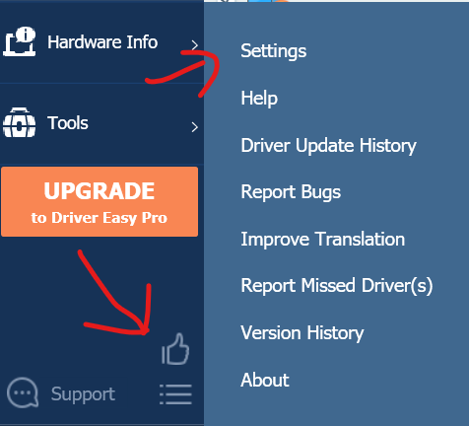
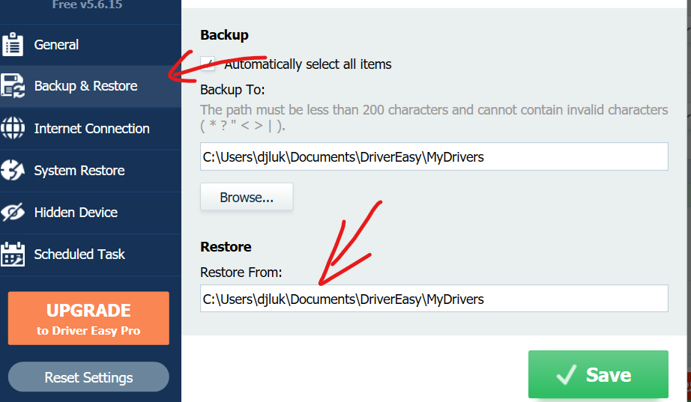
Side steps
Click the lines button in the bottom left of DriverEasy, then click settings
Once settings is open, click Backup & Restore
Now take note of the File Path under Restore
You will need it in the next step

Slide 6
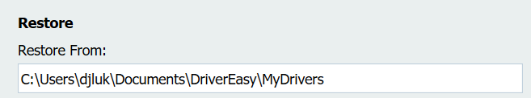
Save the file path
Find the File Path that is labeled “Restore”
Save this File path in a notepad or word doc somewhere for the moment
We will need it later
However you must change some of the path
You want to change everything after and including “Documents\” to “AppData\Roaming\Easeware\DriverEasy\drivers”
For Example: the path I originally had was “C:\Users\djluk\Documents\DriverEasy\MyDrivers”
After I changed it, it became “C:\Users\djluk\AppData\Roaming\Easeware\DriverEasy\drivers”
We will need this File Path for the installation process

Slide 7
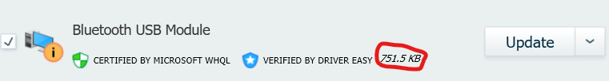
Download an updated driver
Go back to the Update tab on DriverEasy
Find the driver you want download and select update
I recommend doing the smallest sized drivers first, you can find the size next to the driver info; most drivers aren’t bigger than a few MB, but there are some that are larger
I highly recommend taking note of the name of the driver, as that will help you find the proper driver in Device Manager to update

Slide 8
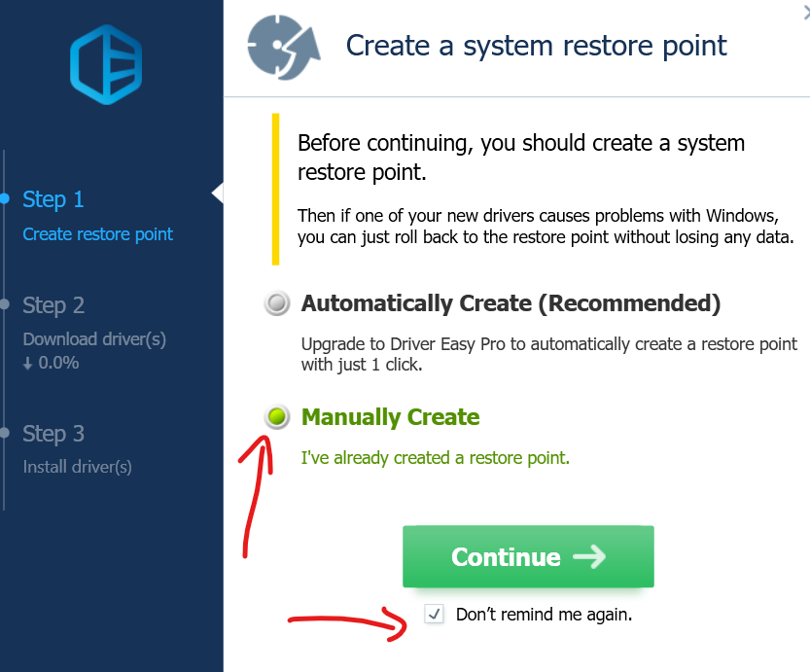
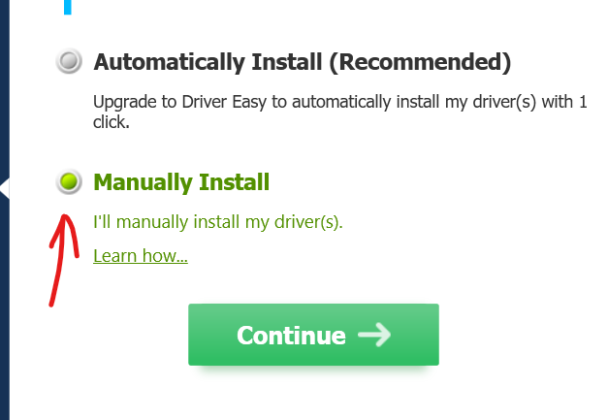
Downloading the driver
After clicking install next to the driver, you will be prompted with this screen
Check the Manually Create and Don’t remind me again buttons
Automatically Create requires payment, so we don’t worry about it
Hit Continue and wait for the driver to download
Depending on how large the driver is, this may take a while
After it downloads, you will be greeted with the screen below
Check Manually Install, then hit Continue

Slide 9
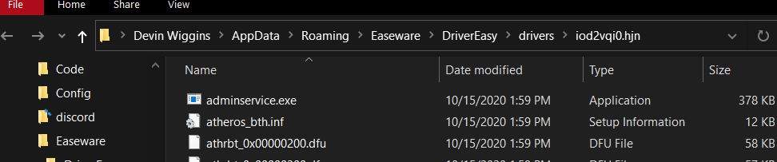
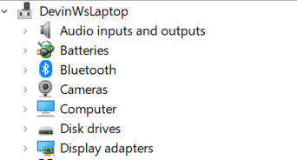
Open device Manager
After you hit continue, DriverEasy should open a file explorer tab that looks like this
You can simply exit out of this as it’s not necessary to keep open
You might also notice that the file path at the top is the same path as the one we created earlier, so if for whatever reason the created path doesn’t work, you can simply copy and paste that one.
Now you can go to the Windows search bar and type “Device Manager,” and open up the first result
You should be greeted with a screen with a lot of devices, like this

Slide 10

The tedious part
Now it is time for the tedious and most difficult part of this process (still not very difficult but can be frustrating at first)
Take a look at the name of the driver you installed, now look through the list and try to find the closest device name to match the driver
Many drivers are named based on the type of driver, such as audio, Bluetooth, and printer names; this will help you find the device you need to update
For example, the driver I updated was “Bluetooth USB Module”, if I open the Bluetooth drop down, I can see the same name under it. So this must be the device for the driver I just downloaded.
Sometimes driver names can be misnamed, if you are 100% sure you don’t see the proper device, clicking the driver name in DriverEasy will show you the name of the current driver that needs to be replaced

Slide 11
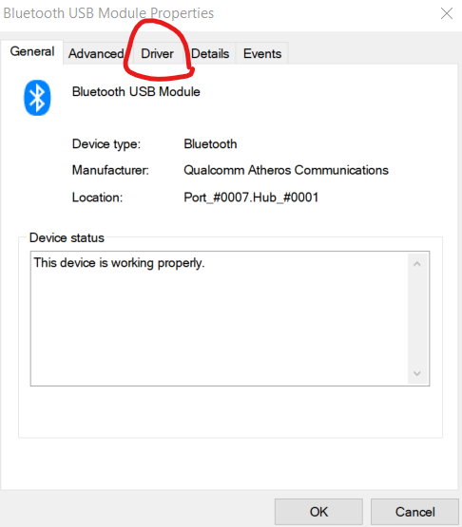

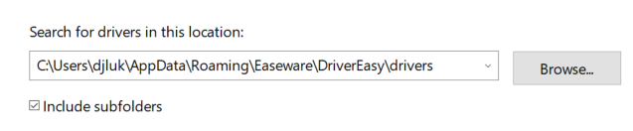
Update the driver
After you find the device that correlates with your driver, double click it to open the device properties, it should look like this
Click the circled tab “Driver,” then select Update Driver
Next select “Browse my computer for drivers”
This is where you need the file path from earlier
Copy and paste that path into the text box, and check the subfolders checkbox
It should look very similar to this

Slide 12
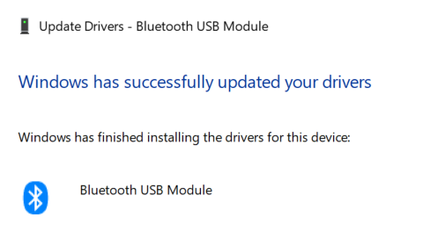
Driver updated!
After you check “include subfolders” and input your file path, simply hit next and Windows will automatically find the correct driver
Congratulations! You’ve successfully updated your own driver. You can now go back to slide 7 and repeat for all the other drivers that require an update.

